Slide 1
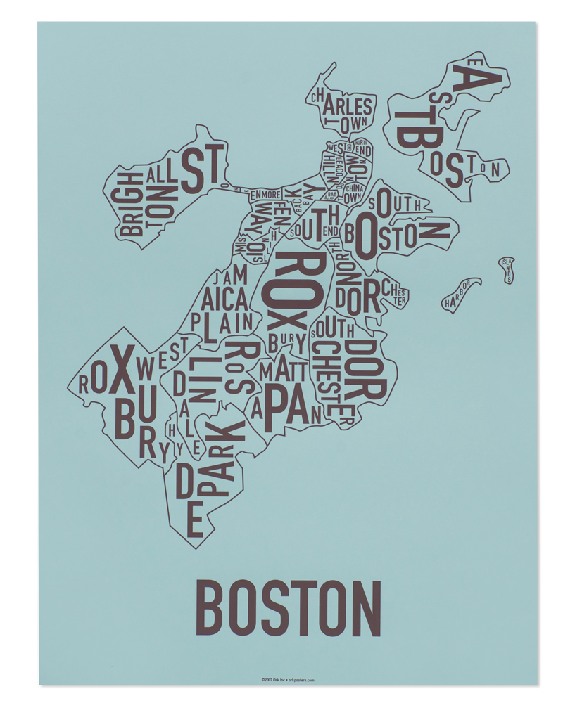
Find the Best Location to Open an Ice Cream Shop in Boston Area
Capstone Project - The Battle of Neighborhoods

Slide 2
Background
Selecting a location for a business is one of the most important decisions in running a business.
Business decision makers need to consider different factors in finding the right location for the business, such as financial factors, market factors, and the factors that will affect their demand and revenue.
This project can help those who are planning to open a new business such as an ice-cream shop and need to find the best location for the shop in a city.

Slide 3
Business Problem
To find the best neighborhood in boston to open an ice cream shop
A suitable neighborhood which is close enough to some amenities and venues, has fewer competitors, and is affordable to rent
An ice cream shop is good to be near a place where many people visit such as near a cinema, park, garden, playground, etc.
A neighborhood that has fewer competitors is less risky for starting a new business.

Slide 4
Data
Extract the information about the neighborhoods of Boston (23 neighborhoods) along with the median one-bedroom rent price (as an estimate of the renting price of the shop) of each neighborhood using the following website and BeautifulSoup website scraping library: http://realestate.boston.com/renting/2019/02/19/median-one-bedroom-rent-price/
Transform the data into pandas dataframe
Use GeoPy Python package to get the latitude and the longitude coordinates of all the neighborhoods of Boston
Map the neighborhoods using Folium Python library
Use Foursquare API to get information about some venues around these neighborhoods

Slide 5
Foursquare API
Looking for a group of venues in walking distance (500 meters) of each of the neighborhood:
Movie Theater, Playground, Park, Garden, Water Park, General Entertainment, Stadium, Amphitheater, Aquarium, Street Art, Beach, Recreation Center, Pedestrian Plaza venues).
These venues are places that many people usually visit them for entertainment and hence we will have good demand for ice cream around them.
Looking for Ice cream shops within walking distance of each of the neighborhoods.
To get an understanding of the competitors in each neighborhood. In total, 23 Ice Cream Shop were found in Boston Area.

Slide 6
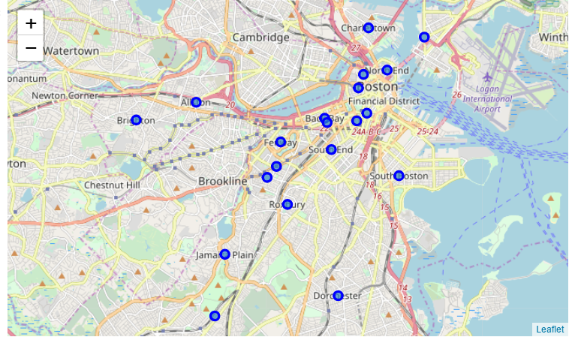
23 neighborhoods of Boston selected for this study

Slide 7
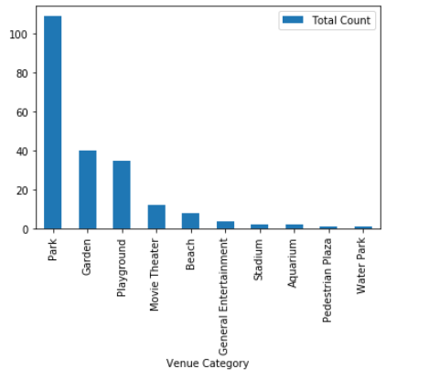
In total, we found 214 venues in Boston.
The most frequent venue is Park.

Slide 8
Methodology
Remove neighborhoods with more than one ice cream shop
Cluster the neighborhoods using k-means to cluster the neighborhood into 5 clusters based on the frequency of different venue categories (except ice-cream shop) around them.
Sort the neighborhoods in each cluster based on their average rent price
Select the neighborhood within the budget limits that has fewer ice-cream shop and more of other venue categories around.

Slide 9
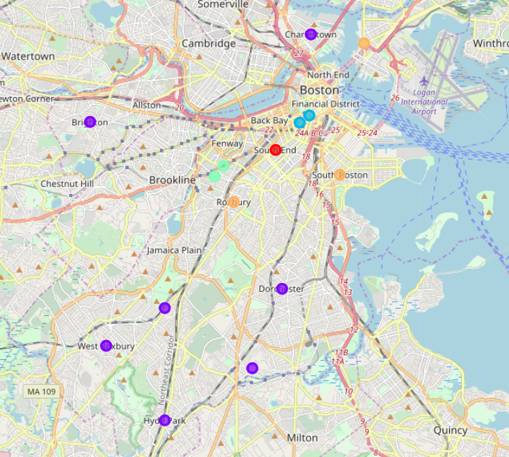
Use KMeans to cluster the neighborhoods of Boston into 5 classes

Slide 10
Results and Discussion
South end boston (in cluster 1) is the best neighborhood to open an ice cream shop in boston.
It has the greatest number of total venues and is expected to attract many people to visit.
The final decision is dependent on the budget of the client to rent the place. According to the budget limitations of the client, we can find other neighborhoods and select the one with the greatest number of venues and a smaller number of ice cream shops around.

Slide 11
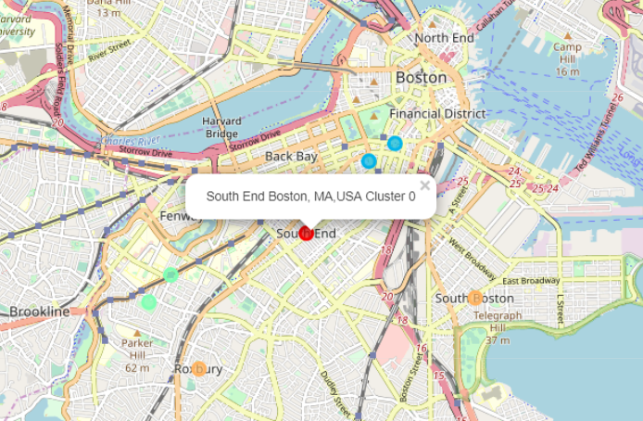
South End Boston with 12 parks, 7 gardens, 4 playgrounds, and one movie theater and no ice cream shop within walking distance is the best neighborhood to open an ice cream shop in Boston

Slide 12
Limitations and Future Extensions
In this study we used the median of one bedroom rent price in each neighborhood as an estimate of the rent price.
We only Investigated the venues within 500 meter of the neighborhoods
we considered equal weights for different venues
As an extension one can consider:
specific locations such as particular streets
use different weights for different venues

